Slide 1
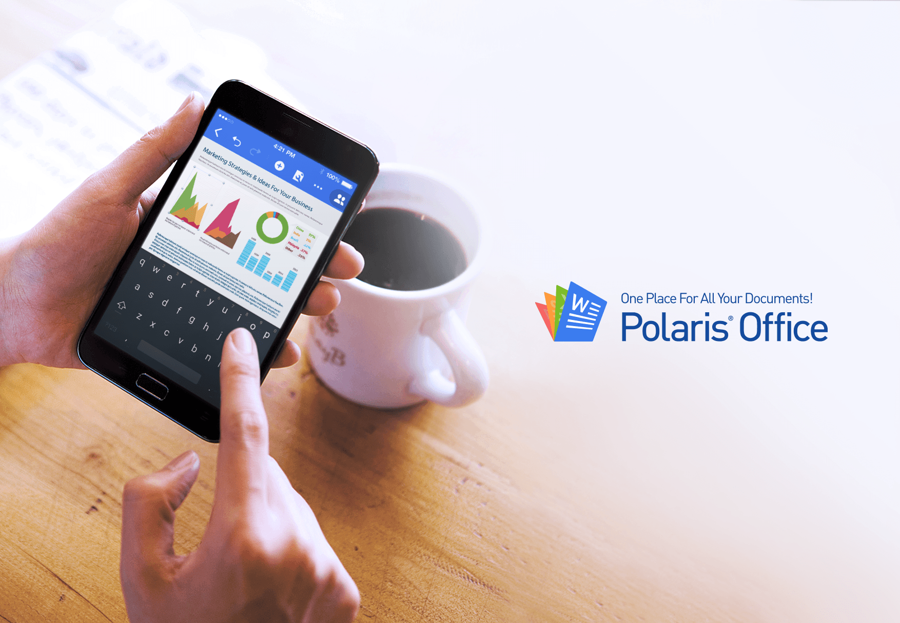

Slide 2
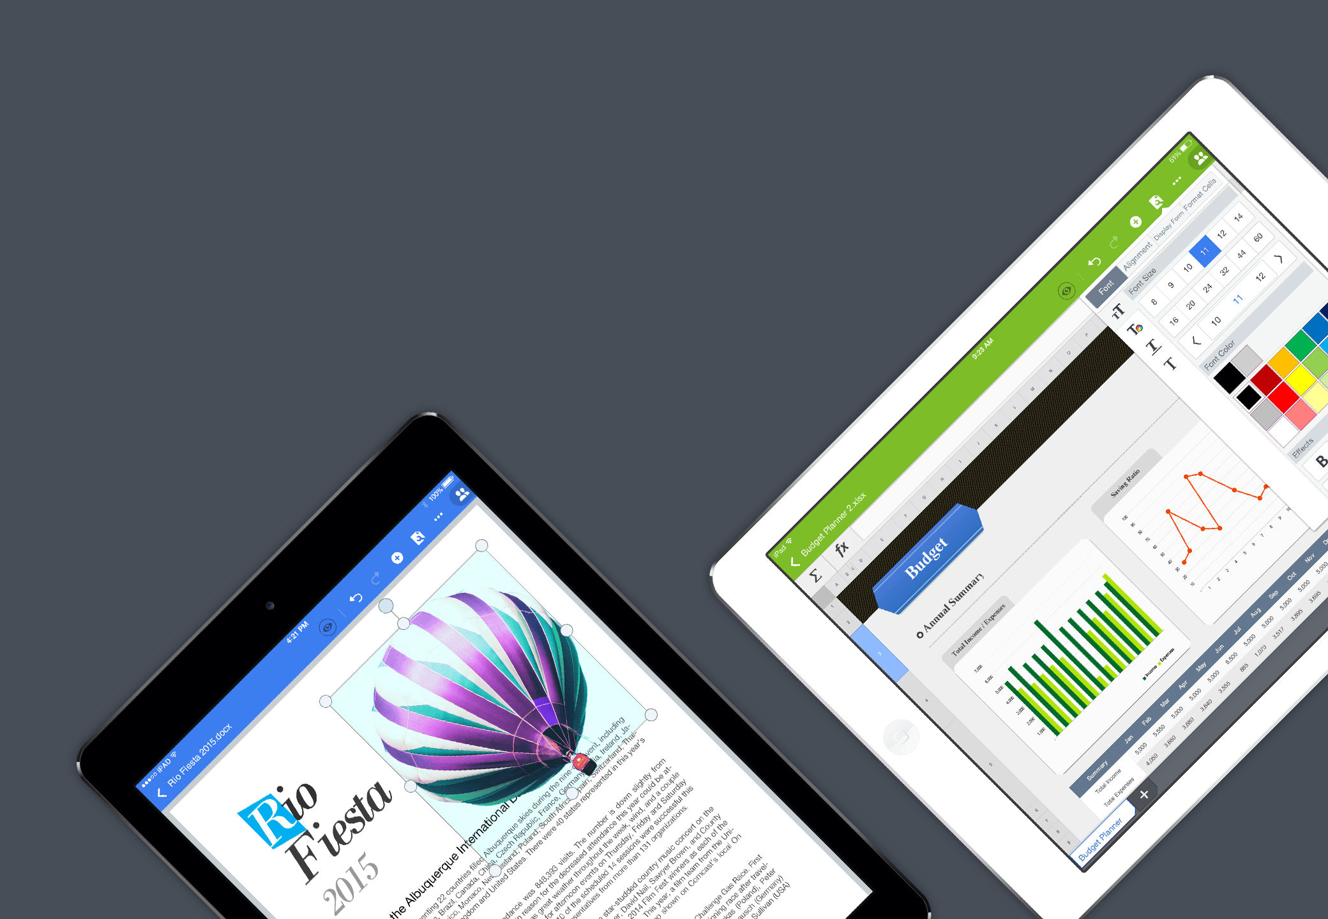

View and edit documents of
various formats with one app.
Don’t use multiple apps for editing MS Office, PDF and TXT files.
Just use one app.

Slide 3
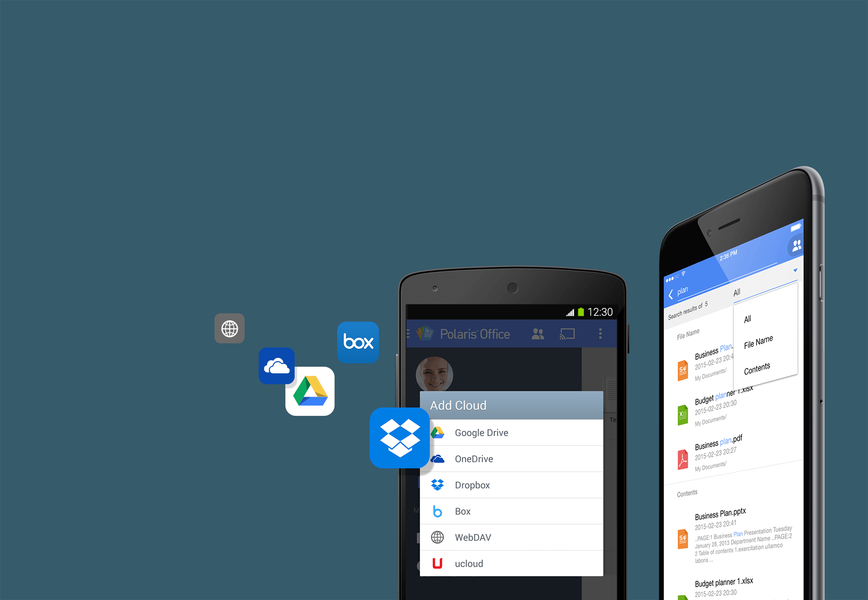
Manage your documents in one place
and easily find the files you need.
You don’t have to remember where you saved your documents.
Manage all your documents from your desktop,
cloud storages and others places in one convenient place.
Easily find your documents by searching for titles and
key words in their content.

Slide 4
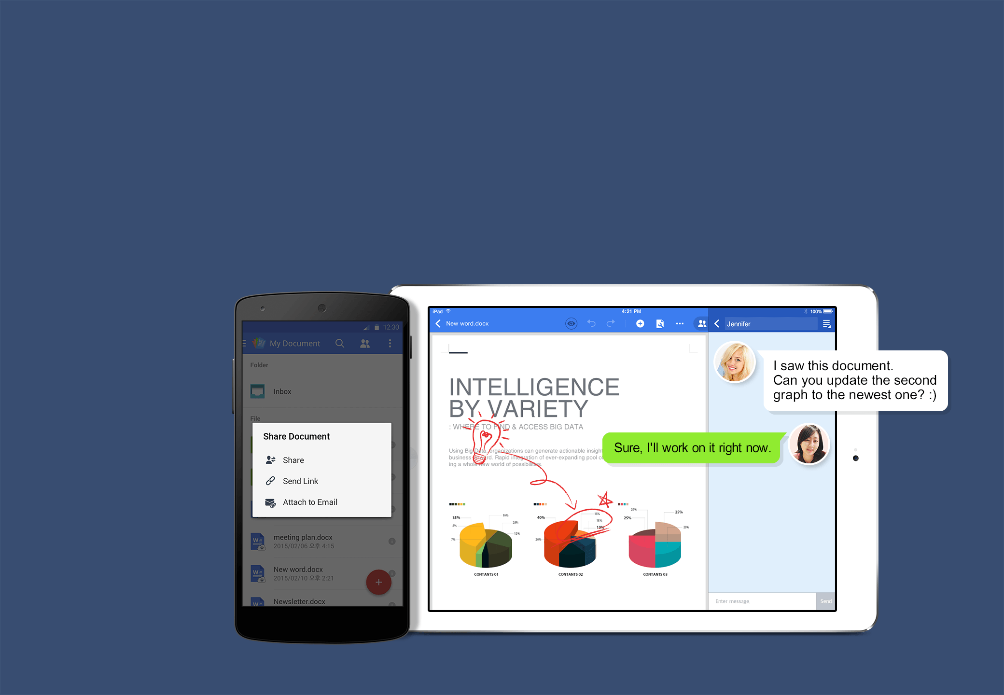
Share your documents
and thoughts with just one tap.
Use your contacts and shareable URL links to easily share and collaborate with others!
There’s no need to meet up to exchange your ideas to work on documents.

Slide 5
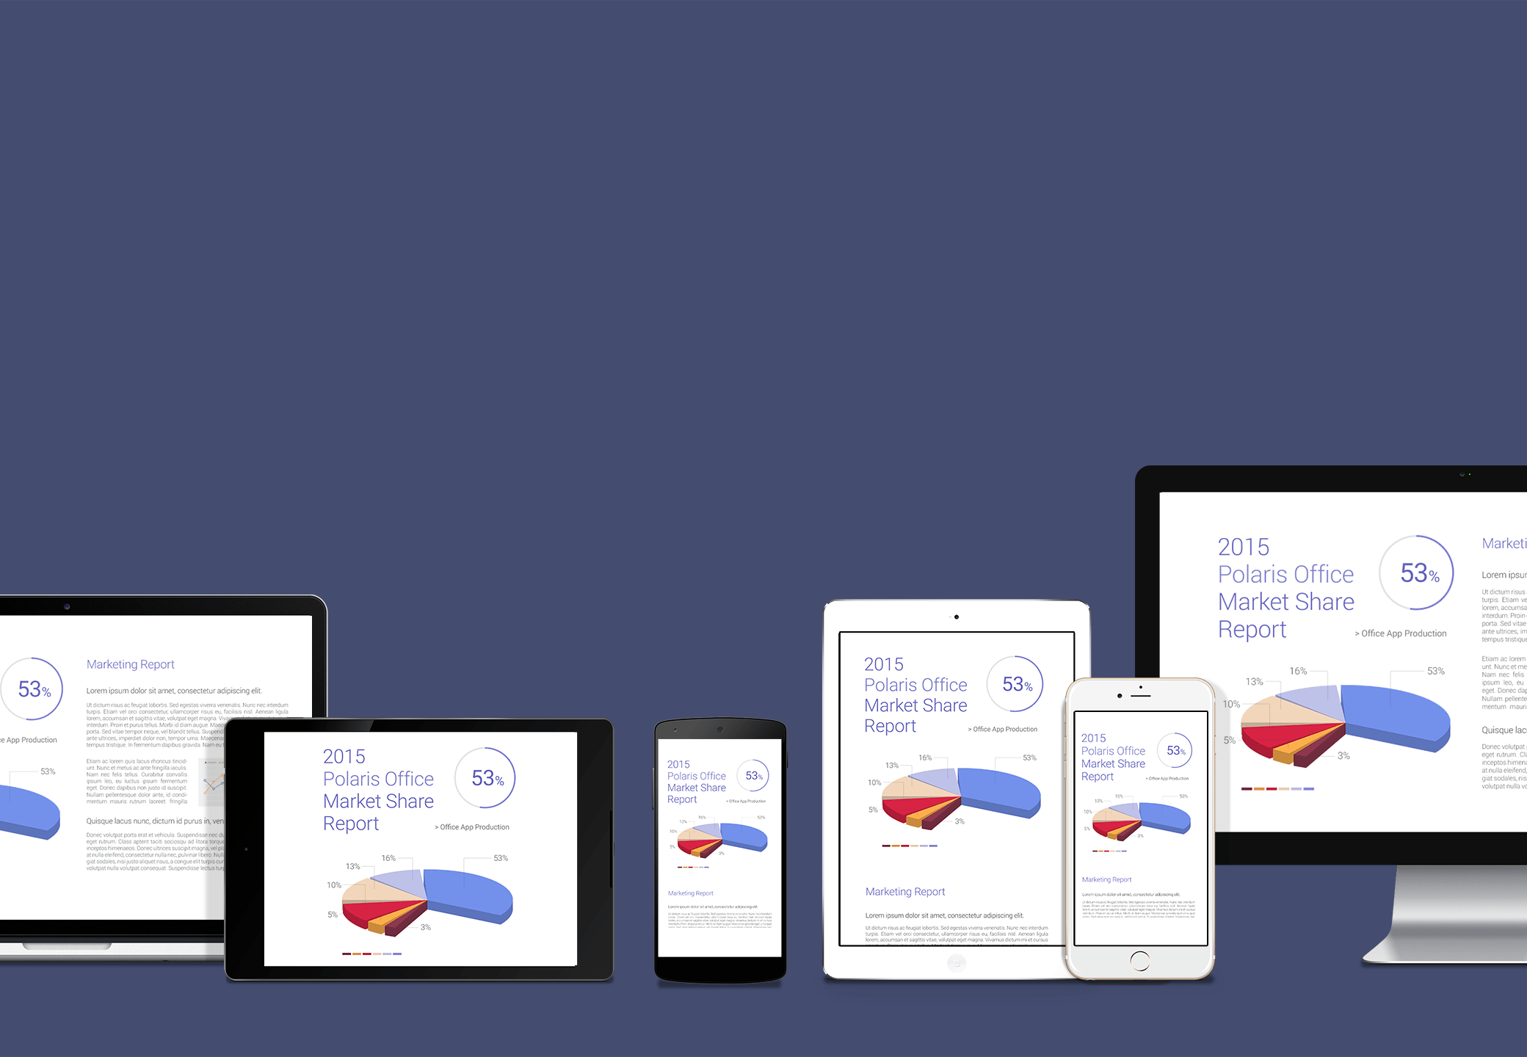
Use any of your mobile devices or desktop
to continue working.
Polaris Office syncs documents on all your connected devices.
View and edit documents from your work, home, or anywhere else!
Link all your work through Polaris Office. Make your work beautiful.

Slide 6

Copyright ©2015 Polaris Office, Inc. All rights reserved

